Slide 1

Movie Recommendation System Using Python and Streamlit
Sharath Kumar Karnati

Slide 2

Introduction
What is a Movie Recommendation System?
A system that suggests movies to users based on their preferences.
Objective : Build a user-friendly app to recommend movies using Python and Streamlit (web).

Slide 3
Methodology
Technologies Used:
Python
Streamlit
TMDB API (for movie posters and details)
Pandas, NumPy, and Pickle (for data processing and model storage)
Recommendation Algorithm:
Content-based filtering using cosine similarity.
Key Features:
Movie selection from dropdown.
Displays top 5 recommended movies with posters.
Option to add movies to favorites.

Slide 4
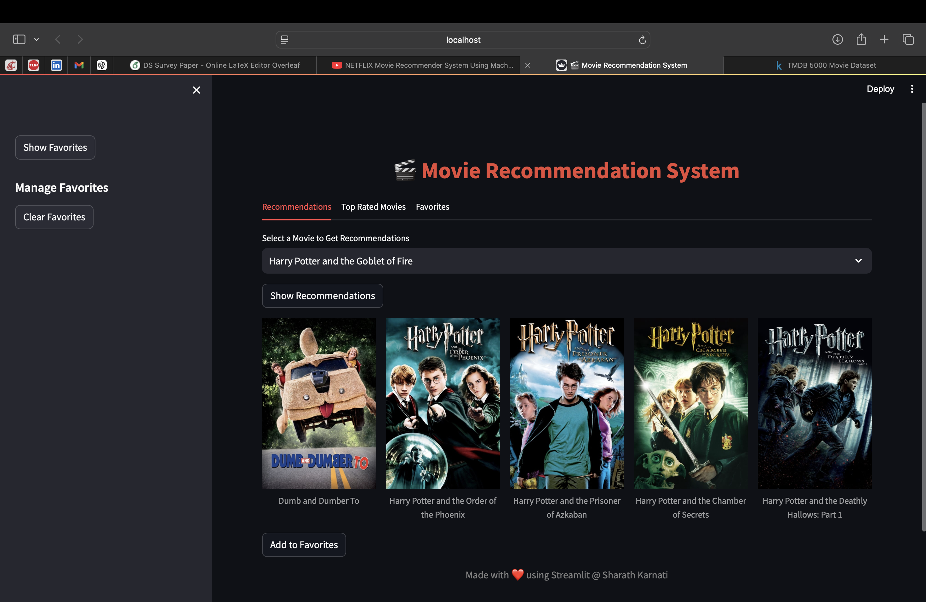
App Workflow
Step 1: User selects a movie from the dropdown or type their choice.
Step 2: System fetches similar movies using pre-computed similarity scores.
Step 3: Displays recommendations with movie posters.
Step 4: User can add favorites, which are saved in session state.

Slide 5
DEMO

Slide 6
Conclusion and Future Work
Conclusion : Successfully developed a functional and visually appealing movie recommendation system.
Future Enhancements :
Add collaborative filtering for better recommendations.
Allow user reviews and ratings.
Deploy the app for public use.

Slide 7

Thank You

